Slide 1
HOUSE SELLING
Created by: Illés Máté and Havasi Márk
Notes:
Introduction The goal of our house selling website is to make the process of renting or purchasing apartments and properties easier for both those searching for them and those offering them. This website operates as online platform where demand and supply meet. In the following, I will explain in detail the purpose of an apartment reservation website, the features it offers, and why it has become indispensable in the modern real estate market.

Slide 2

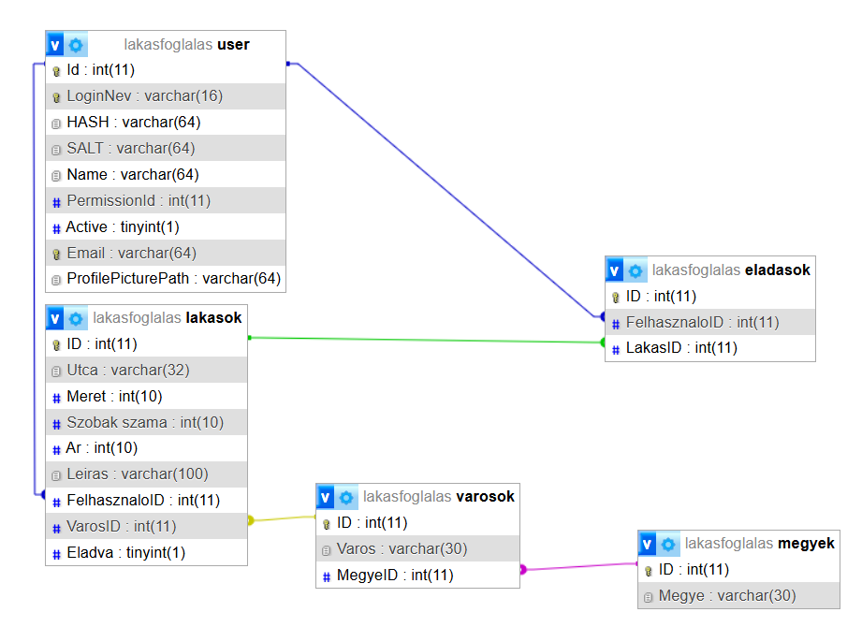
SQL
Notes:
SQL, or Structured Query Language, is the query language for relational database management systems.
Relational database management systems are generally programmable using SQL. The fundamental SQL commands are implemented in a nearly identical manner, but there are significant differences and incompatibilities in the later-added language elements. As a result, we can speak of multiple SQL dialects.

Slide 3
Objective and Problem:
Simplifies apartment searching
Helps find cheaper options
Provides a reliable selection

Slide 4
Languages Used:
HTML
CSS
JavaScript
Notes:
HTML HTML forms the foundation of our website. Our project is built on the principles of HTML. HTML (HyperText Markup Language) is a hyperlink language developed for creating websites, and it has become an internet standard supported by the W3C (World Wide Web Consortium).
CSS CSS is responsible for the appearance of our project, such as the background, font style, size, etc. CSS (Cascading Style Sheets) is a style sheet language used to describe the presentation of HTML or XHTML type structured documents.
JavaScript JavaScript is responsible for the buttons found on our site, such as the "Login" button. JavaScript is an object-oriented, prototype-based scripting language widely used on websites. TypeScript, a typed version of JavaScript, developed from it.

Slide 5
Frontend
Developed using React
Includes a login interface
Uses navigation links
Notes:
React React is an open-source JavaScript library developed and maintained by Meta (formerly Facebook). React is primarily used to build user interfaces (UI), especially for single-page applications (SPA), where quickly and efficiently updating interactive elements is crucial.

Slide 6
Desktop Application:
Login interface
Apartment management
User management
Permissions
Notes:
The system enables administrators to efficiently manage users and apartments.
User Management:
Creating, modifying, and deleting user accounts
Managing user permissions
Viewing activity logs and access history
Apartment Management:
Registering new apartments and updating their details
Managing rental statuses and ownership information
Administering maintenance and other related data
Administrator privileges ensure appropriate access control, guaranteeing data security and integrity.

Slide 7
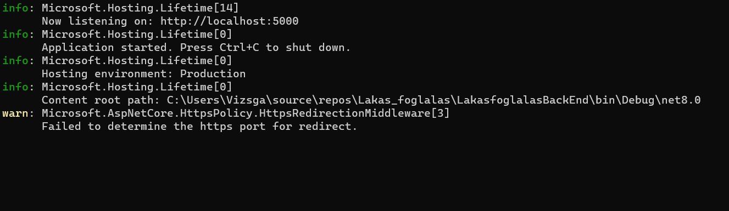
Backend:
Connects the database with the desktop application
Grants permissions to clients and advertisers
Notes:
Backend A backend system that helps manage and track apartments. Essentially, it is a "data center" that stores information related to apartments and users.
The system provides four main functions:
Query (GET): You can view the apartments available in the system and the data associated with them.
Add (POST): New apartments and users can be recorded.
Modify (PUT): If an apartment or user’s data changes, it can be updated here.
Delete (DELETE): If a user is inappropriate, they can be removed from the database.
The program ensures that only those who truly need access to the data can retrieve it, thus preventing abuse or accidental deletion. The goal is to create a reliable and user-friendly system, which can even be integrated with other healthcare software.

